Slide 1

The National University of Computer and Emerging Sciences
Programming Fundamentals
CS 1002 Programming Fundamentals
Dr. Akhtar Jamil
Department of Computer Science

Slide 2
Goals
Review of Previous Lecture
Getting started with c++.

Slide 3
Review of Previous Lecture

Slide 4
C vs. C++
Advantages:
1. Faster development time (code reuse)
2. Creating / using new data types is easier
3. Easier memory management
4. Stricter syntax & type checking => less bugs
5. Easier to implement Data hiding
6. Object Oriented concepts

Slide 5
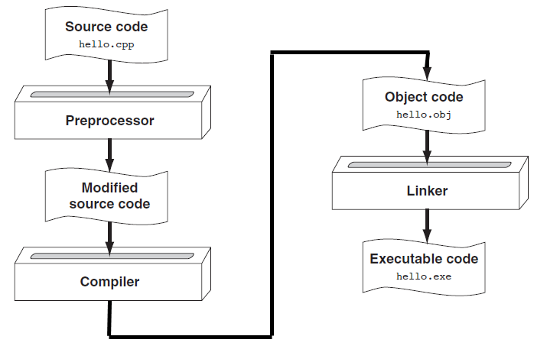
C++ Program Compilation

Slide 6
What Is a Program Made Of?
Common elements in programming languages:
Key/reserved words (predefined meaning)
Programmer-defined identifiers (rules apply)
Operators (e.g., + for “add, * for multiply)
Punctuation (symbols that organize, e.g., comma (,), semicolon(;), parentheses, etc.)
Syntax ( rules of “grammar” )
Notes:
See pr1-01.cpp

Slide 7
Preprocessor Directives
#include<iostream>
# is a preprocessor directive
The preprocessor runs before the actual compiler and prepares your program for compilation.
Lines starting with # are directives to preprocessor to perform certain tasks, e.g., “include” command instructs the preprocessor to add the iostream library in this program

Slide 8
namespace
A namespace is a declarative region that provides a scope to the identifiers
the names of types, functions, variables, etc. inside it.
Namespaces are used to organize code into logical groups and to prevent name collisions.
Example: We cannot create two variables with same name, but within different name spaces we can create.

Slide 9
Today’s Lecture

Slide 10
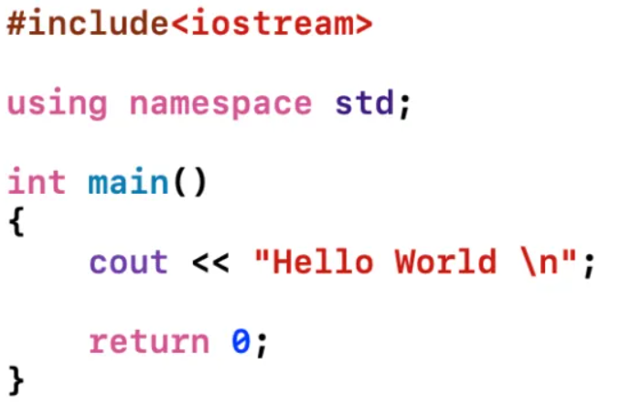
C++ Program
Preprocessor Directive
Standard Namespace
main function
Print message on screen
end main function

Slide 11
main( ) function
Every C++ program start executing from main ( )
A function is a construct that contains/encapsulates statements in a block.
Block starts from “{“ and ends with “}” brace
Every statement in the block must end with a semicolon ( ; )
Examples…

Slide 12
Example Program 1
#include <iostream>
using namespace std;
int main()
{
int num1 = 5, num2, sum;
num2 = 12;
sum = num1 + num2;
cout << "The sum is " << sum;
return 0;
}

Slide 13
Example Program 2
#include <iostream>
using namespace std;
int main()
{
int num1 = 5, num2, sum;
cout << “Enter second number: “;
cin >> num2
sum = num1 + num2;
cout << “The sum is “ << sum;
return 0;
}

Slide 14
Example Program 2
#include <iostream>
using namespace std;
void main()
{
int num1 = 5, num2, sum;
cout << “Enter second number: “;
cin >> num2
sum = num1 + num2;
cout << “The sum is “ << sum;
}

Slide 15
Key Words
Also known as reserved words
Have a special meaning in C++
Can not be used for another purpose
Written using lowercase letters
Examples in program (shown in green):
using namespace std;
int main()

Slide 16
Some C++ Reserve Words
auto break
case char
const continue
default do
double else
enum extern
float for
goto if
int long
register return
short signed
sizeof static
struct switch
typedef union
unsigned void
volatile while

Slide 17
Programmer-Defined Identifiers
Names made up by the programmer
Not part of the C++ language
Used to represent various things, such as variables (memory locations)
Example in program (shown in green):
int num1;

Slide 18
Variables
A variable is a name for a cell in computer memory (RAM) where a value can be stored.
The memory cell (variable) holds a data value
A variable must be defined before it can be used
Example variable definition (declaration):
double num1;

Slide 19
Variables
- Variables are identifiers which represent some unknown, or variable-value.
- A variable is named storage (some memory address’s contents)
x = a + b;
Speed_Limit = 90;

Slide 20
Declaring Variables
TYPE <Variable Name> ;
Examples:
int marks;
double Pi;
int suM;
char grade;
- NOTE: Variable names are case sensitive in C++ ??

Slide 21
Declaring Variables
C++ is case sensitive
Example:
area
Area
AREA
ArEa
are all seen as different variables

Slide 22
Variable Names
Valid Names:
Start with a letter
Contains letters
Contains digits
Contains underscores
Do not start names with underscores: _age
Don’t use C++ Reserve Words

Slide 23
Variable Names
Choose meaningful names
Don’t use abbreviations and acronyms: mtbf, TLA, myw, nbv
Don't use overly long names
Ok:
partial_sum element_count staple_partition
Too long (valid but not good practice):
remaining_free_slots_in_the_symbol_table

Slide 24
Which are valid variable names?
AREA
2D
Last Chance
x_yt3
Num-2
Grade***
area_under_the_curve
_Marks
#values
areaoFCirCLe
%done
return
Ifstatement

Slide 25
Declaring Variables…
When we declare a variable, what happens ?
Memory allocation
How much memory (data type)
Memory associated with a name (variable name)
The allocated space has a unique address
Marks
int Marks;
%$^%$%$*^%
FE07

Slide 26
Variables Initialization
Variables may be given initial values, or initialized, when declared. Examples:
int length = 7 ;
float diameter = 5.9 ;
char initial = ‘A’ ;
length
7
diameter
5.9
initial
‘A’

Slide 27
Type | Typical Bit Width | Typical Range
char | 1byte | -127 to 127 or 0 to 255
unsigned char | 1byte | 0 to 255
signed char | 1byte | -127 to 127
int | 4bytes | -2147483648 to 2147483647
unsigned int | 4bytes | 0 to 4294967295
signed int | 4bytes | -2147483648 to 2147483647
short int | 2bytes | -32768 to 32767
unsigned short int | 2bytes | 0 to 65,535

Slide 28
long long int | 8bytes | -(2^63) to (2^63)-1
unsigned long long int | 8bytes | 0 to 18,446,744,073,709,551,615
float | 4bytes
double | 8bytes
long double | 12bytes
wchar_t | 2 or 4 bytes | 1 wide character

Slide 29
Operators
Used to perform operations on data
Many types of operators:
Arithmetic: +, -, *, /
Assignment: =
Input: >> - Output: <<
Examples in program (shown in blue):
num2 = 12;
sum = num1 + num2;
cin >> num2; cout << sum;

Slide 30
Punctuations
Characters that mark the end of a statement, separate items in a list, and separate elements of a statement.
Example in program (shown in blue):
int main ( )
{
double num1, num2=3, num3;
num1=5;
cout << sqrt(num2);
}

Slide 31
Lines vs. Statements
In a source (.cpp) file,
A line is all of the characters entered before a carriage return (ENTER key).
Blank lines improve the readability of a program.
Here are four sample lines. Line 3 is blank:
double num1 = 5, num2, sum;
num2 = 12;
sum = num1 + num2;

Slide 32
Lines vs. Statements
A statement is an instruction to the computer to perform an action.
A statement may contain keywords, operators, programmer-defined identifiers, and punctuation.
A statement may fit on one line, or it may occupy multiple lines.
Here is a single statement that uses two lines:
double num1 = 5,
num2, sum;

Slide 33
Comments
Two types of comments
Single line comment: // my program
Multi-line (paragraph) comment:
/* my
Program */
The compiler ignores all the comment related text

Slide 34
Input / Output Example
#include <iostream>
#include <string>
using namespace std;
int main ( )
{
string name; //Name of student
cout<< “Enter you name";
cin>>name;
/* Now print hello , and students name */
cout<< “Hello “ << name;
return 0;
}

Slide 35
Omitting std:: prefix
- using directive brings namespaces or its sub-items into current scope
#include<iostream>
using namespace std;
int main()
{
cout<<“Hello World!”<<endl;
cout<<“Bye!”;
return 0;
}

Slide 36
Namespaces
Namespace pollution
Occurs when building large systems from pieces
Identical globally-visible names clash
How many programs have a “print” function?
Very difficult to fix
using namespace std; cout<<“Hello World”;
std is a standard C++ namespace,
You can define your own namespaces too (we see this in future)

Slide 37
String input (Variables)
// Read first and second name
#include<iostream>
#include<string>
int main() {
string first;
string second;
cout << “Enter your first and second names:";
cin >> first >> second;
cout << "Hello “ << first << “ “ << second;
return 0;
}

Slide 38
Tasks
Write a Program that takes three numbers as input and prints the average.
Write a program that produces the following output
* * * *
* * *
* *
*
Write a program that produces the following output
/**********\
\**********/

Slide 39
References
Credit goes to Dr. Muhammad Aleem for preparation of slides
Text book: Starting out with c++

Slide 40
Thank You ☺

